Slide 1

LENDING CLUB CASE STUDY PROJECT ANALYSIS REPORT
Project Team
Group Facilitator: Arjun Khanna
Group Member: Anupam Gogia

Slide 2
EXECUTIVE SUMMARY
Project Goal: Identify target attributes from the loan corpus data and help predict risk score for potential defaulting loan applicants.
Method:
Use appropriate techniques to cleanse data.
Prepare data for further analysis.
Leverage EDA techniques (univariate, bivariate, derived metrics) to analyse data and determine influencing variables in loan processing.
After data cleaning, identified 22 features that has high impact on determining defaulting loan applicants.
Recommendation(s): Using EDA analysis, identified following 8 features sets that determines potential defaulting loan applicants.
[funded_amnt (or derived column funded_amnt_bucket), int_rate (or derived column int_rate_bucket), Dti (or derived column int_rate_bucket), open_acc (or derived column open_acc_bucket), purpose, term, grade, addr_state]

Slide 3
DATA CLEANSING
APPROACHES USED TO REMOVE UNNECESSARY COLUMNS:
Features with high NA values & non-business critical columns
Features with payment details
Data with poorly distributed values which can’t be categorized for meaningful analysis
Desc, URL, delinq_amnt, acc_now_delinq, application_type, policy_code, pymnt_plan, chargeoff_within_12_mths, collections_12_mths_ex_med, tax_liens, initial_list_status, emp_title, recoveries, collection_recovery_fee, delinq_2yrs columns are dropped because it does not have any useful information, has null values in the maximum # of rows or values not well distributed.
The “out_prncp, out_prncp_in, total_pymnt, total_pymnt_inv, total_rec_prncp, total_rec_int, total_rec_late_fee, loan_amnt, zip_code, revol_bal, last_pymnt_d, last_pymnt_amnt, last_credit_pull_d, member_id” features provide repetitive information and payment information of applicants, and hence the same is dropped for further analysis
Reduced # of columns from 111 to 22 for further analysis
After dropping these features, 39 features remained for further analysis
After dropping these features, 25 features remained for further analysis

Slide 4
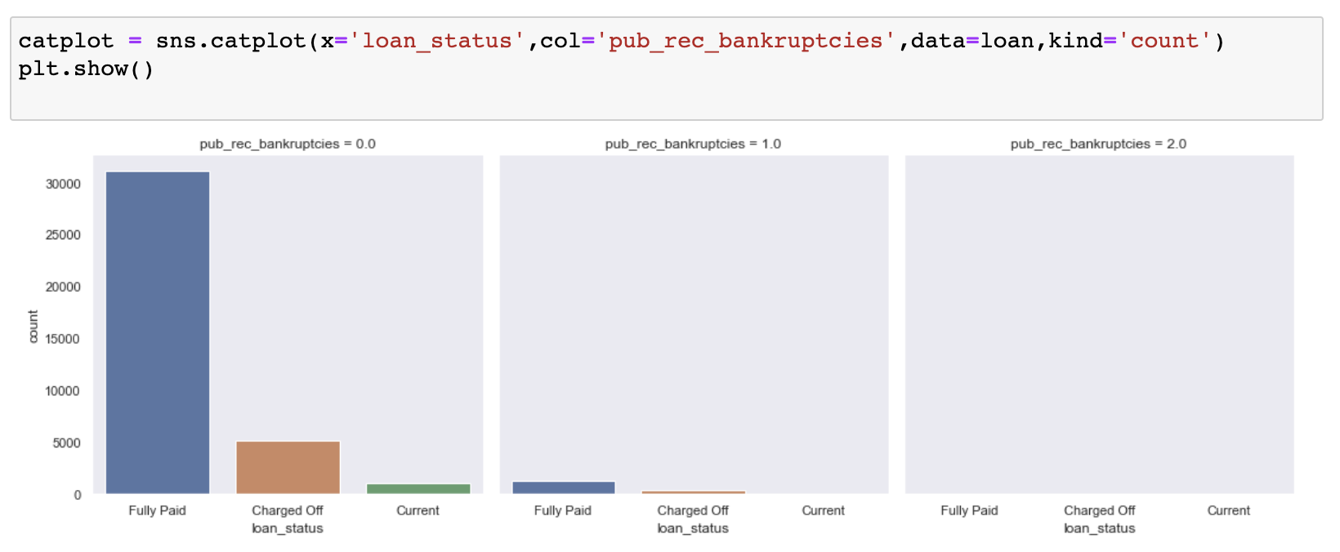
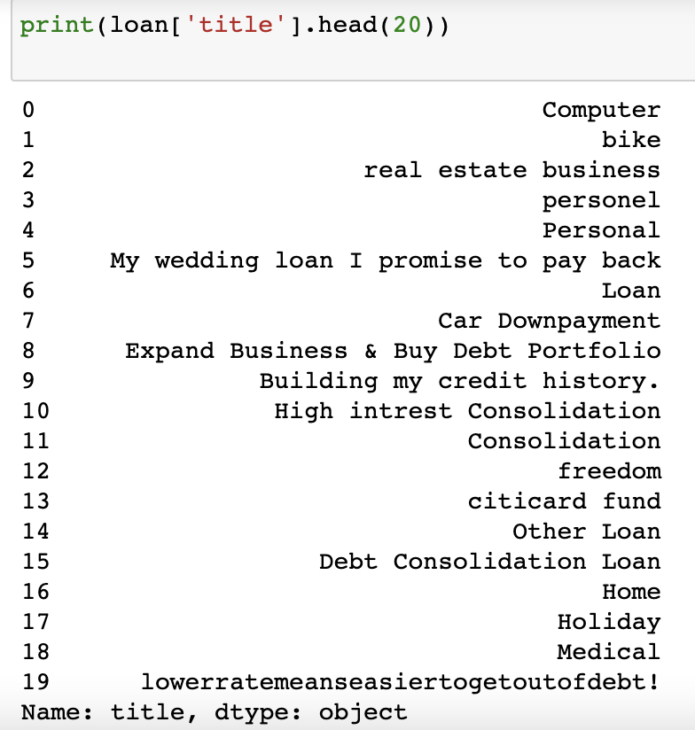
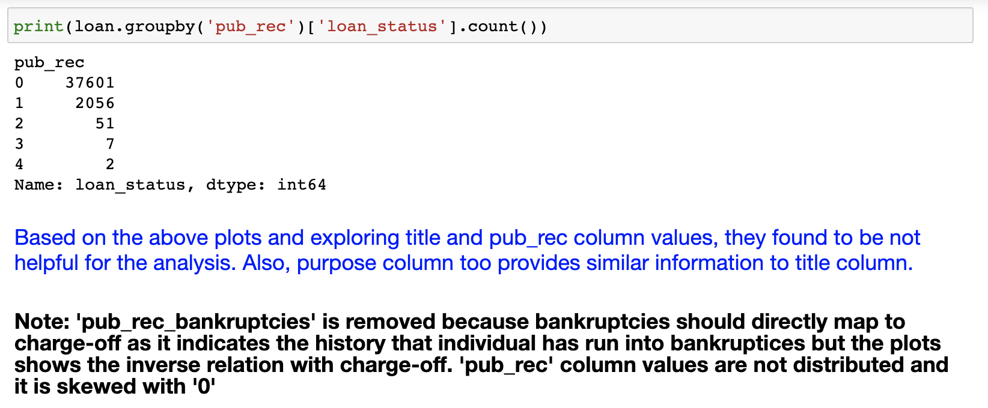
DATA CLEANSING (CONTD.)
pub_rec_bankruptcies, title, pub_rec are dropped based on below analysis:
After dropping these features, 22 features remained for further analysis

Slide 5
DATA PREPARATION
Emp_length column is processed and converted to numerical dataset.
Issue_d column is split into day, month and year values for analysis
The records with ‘Current’ loan status is not considered for further processing as it does not have any information about potential defaults.
Junk characters (%) are removed from int_rate and revol_util columns

Slide 6
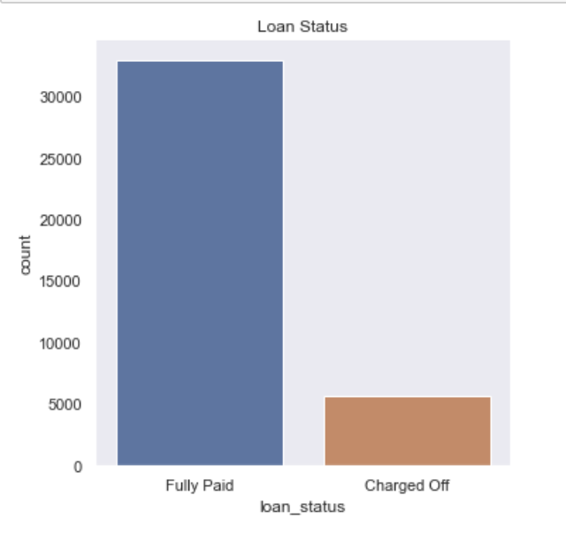
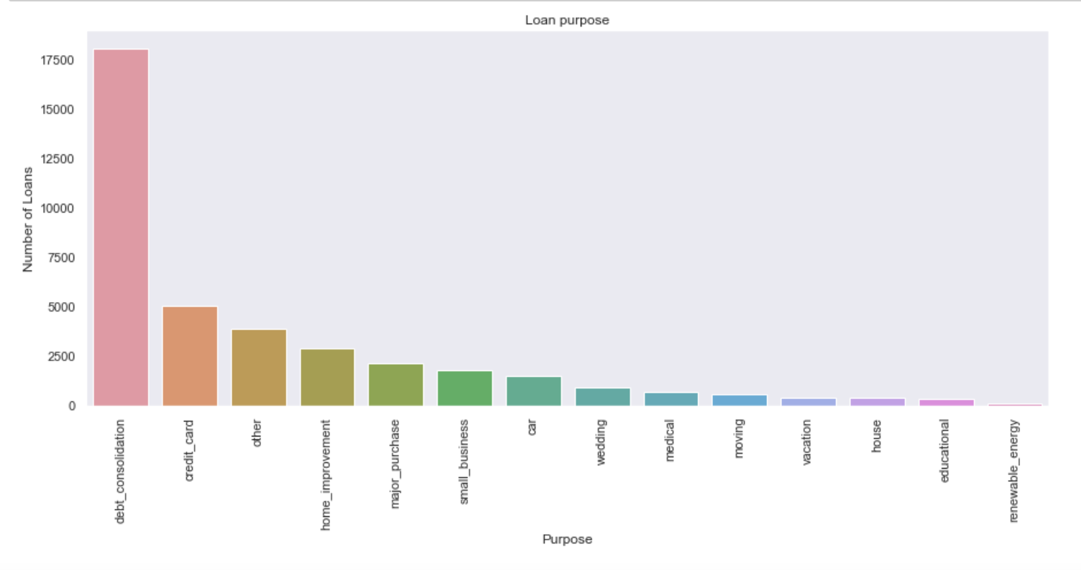
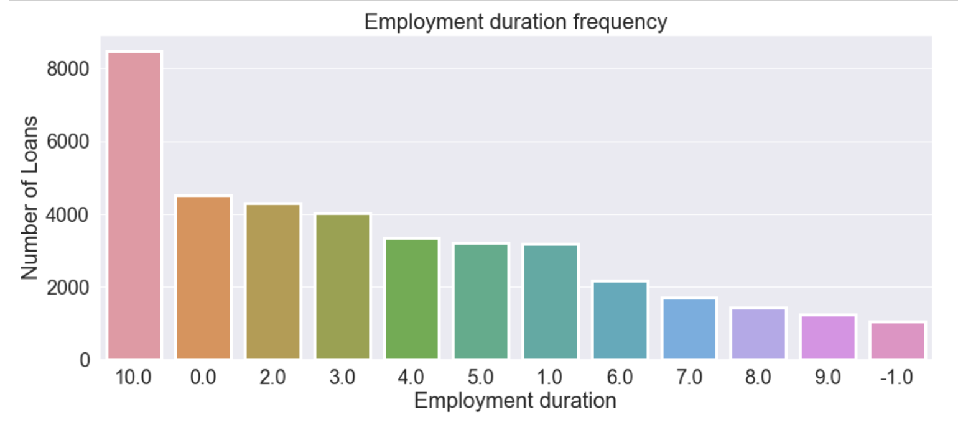
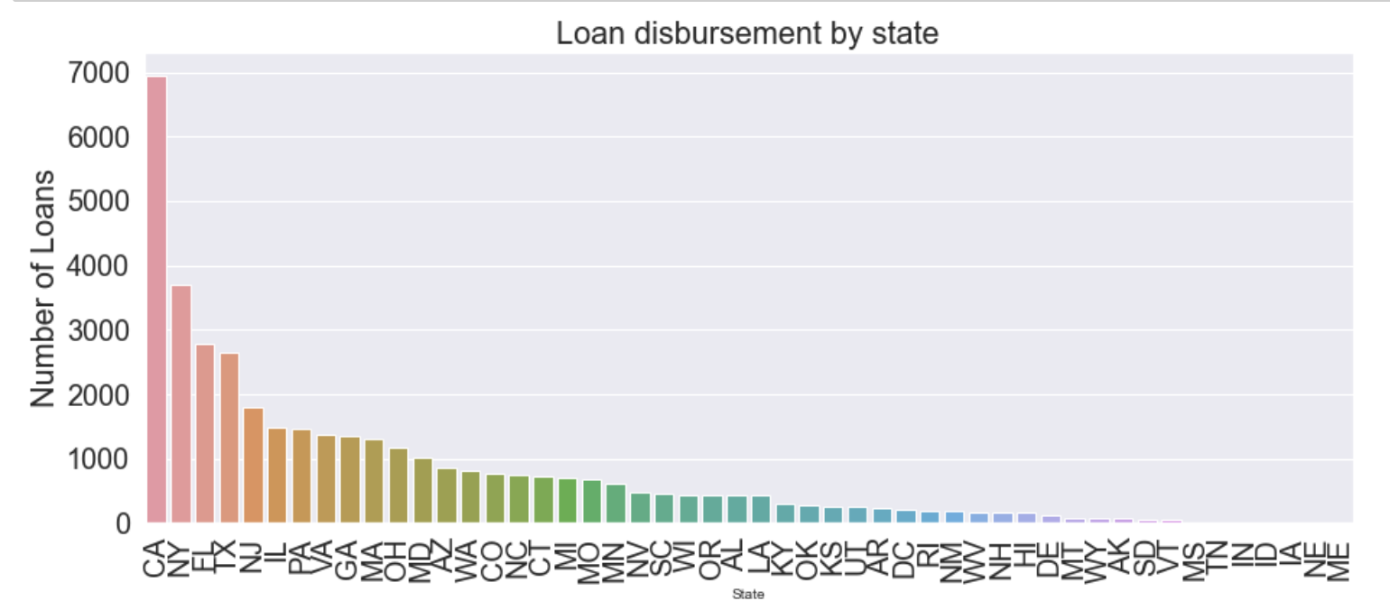
UNIVARIATE: CATEGORICAL ANALYSIS – SAMPLE CHARTS

Slide 7
UNIVARIATE: CATEGORICAL ANALYSIS - INFERENCE
Loan Status: 85% of the total loans are fully paid while only 15% are charged off.
Loan Purpose: Most loans have been taken for debt consolidation.
Loan by State: CA, NY, FL, TX and NJ are the top states where maximum number of loans were issued.
Loan by Employment Duration: People with 10 or more years of experience are the ones who have maximum number of loan accounts, followed by those who have just started their career.

Slide 8

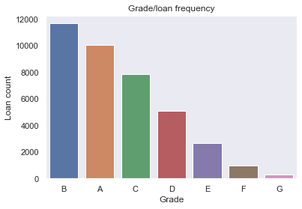
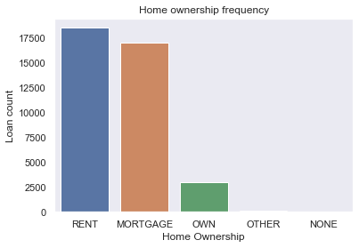
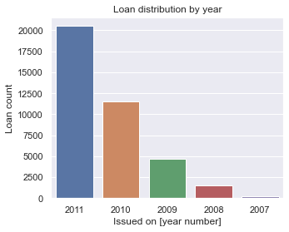
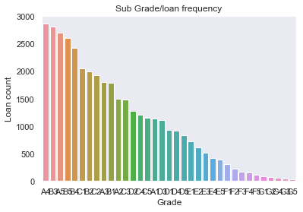
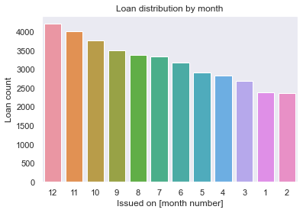
UNIVARIATE: CATEGORICAL ANALYSIS – SAMPLE CHARTS

Slide 9
UNIVARIATE: CATEGORICAL ANALYSIS - INFERENCE
Loans by Grade and subgrade: It is observed that there are more loans in grade B followed by A. However, subgrades loan frequency is slightly different.
Loan by Home Ownership: There are more loans from those who don’t own a home.
Loan by Year and Month: There is an increasing trend in the number of loans disbursed each year. Most loans are taken around the month of December.

Slide 10
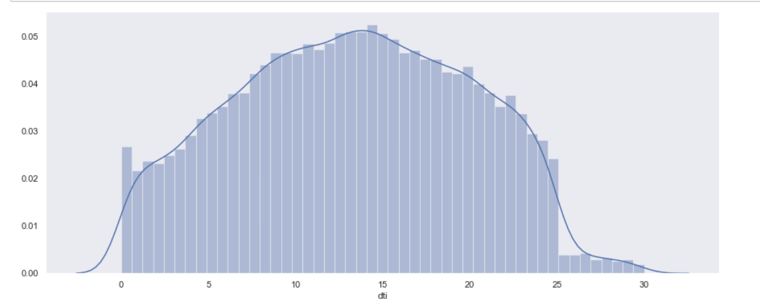
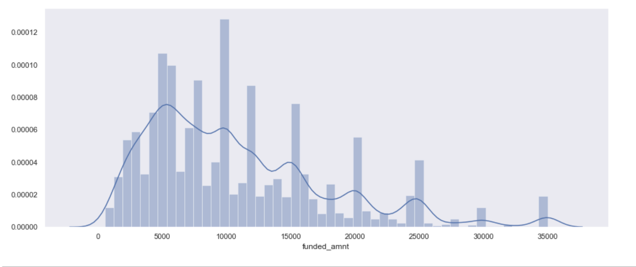
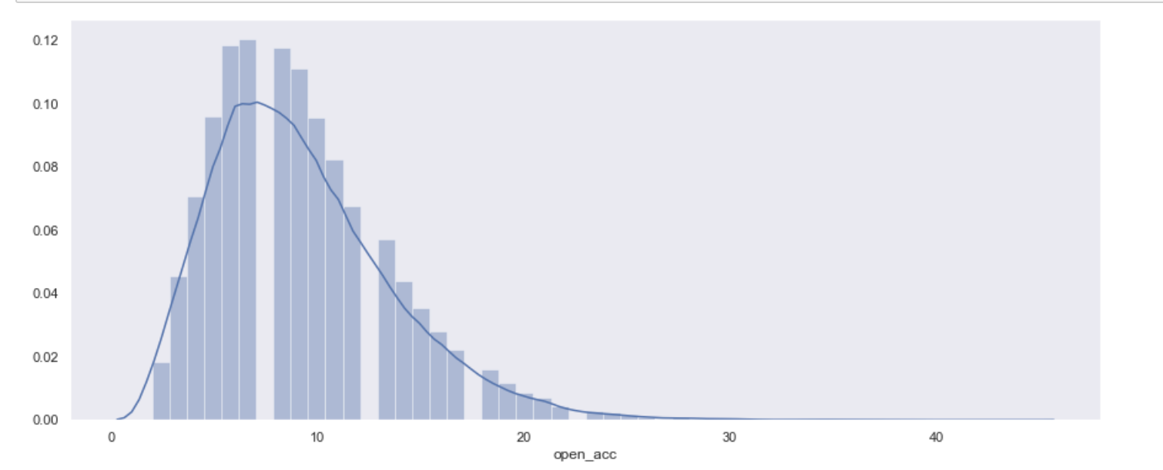
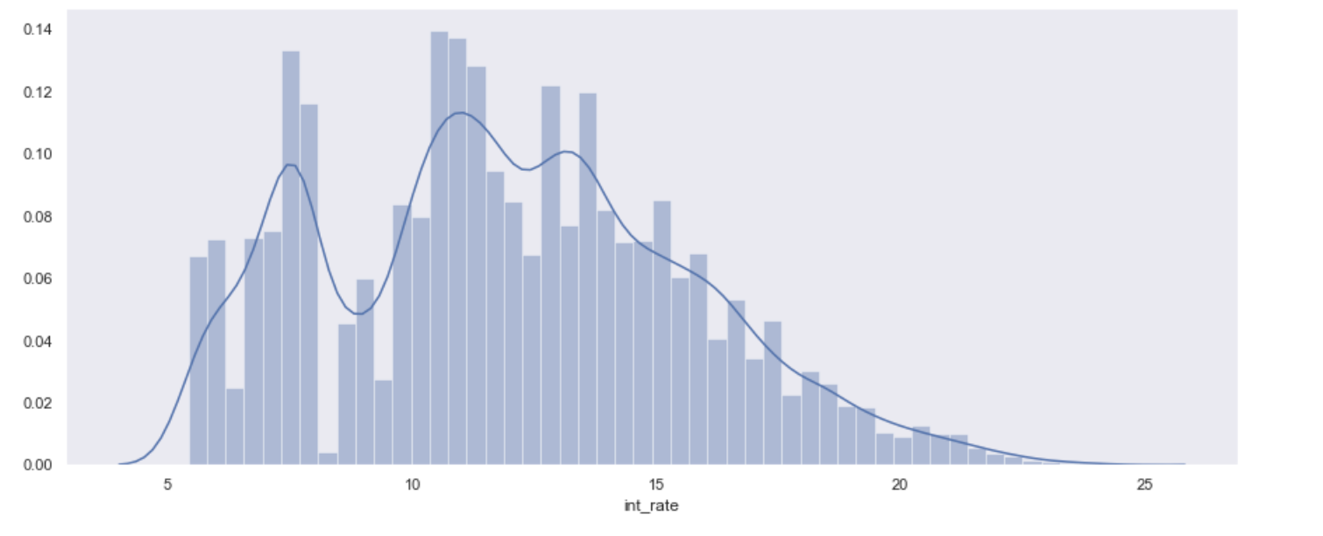
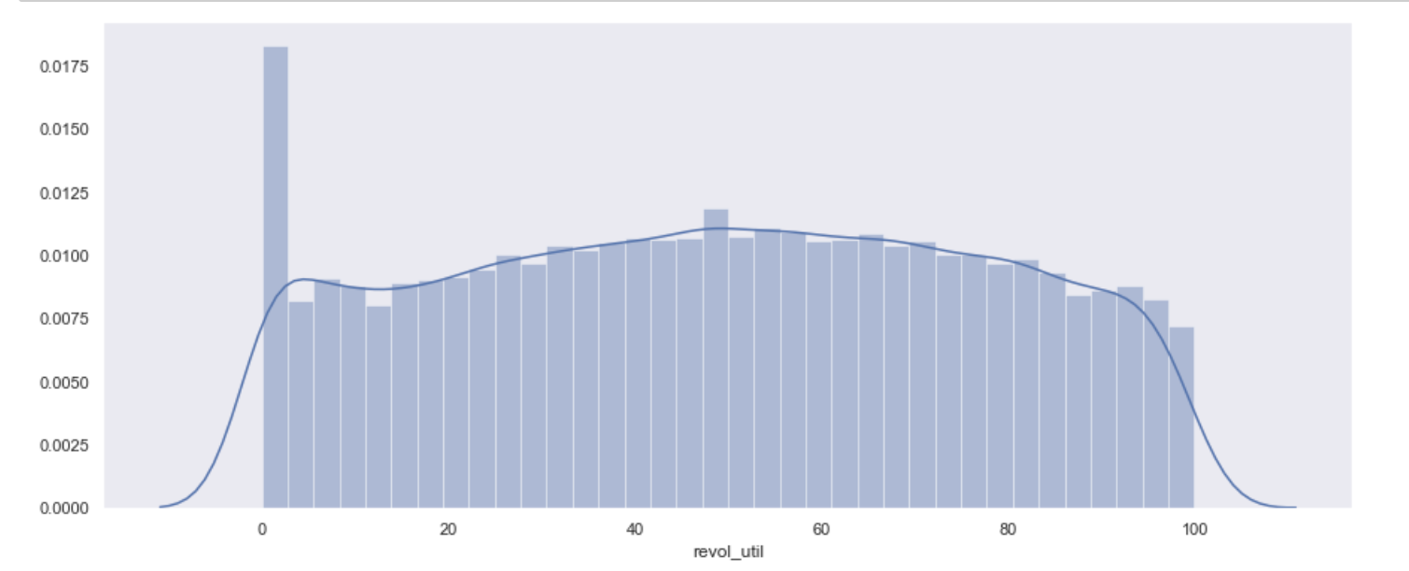
UNIVARIATE: CONTINOUS ANALYSIS – SAMPLE CHARTS

Slide 11
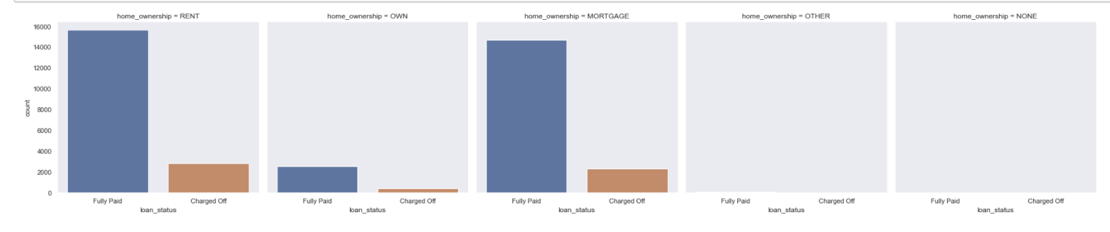
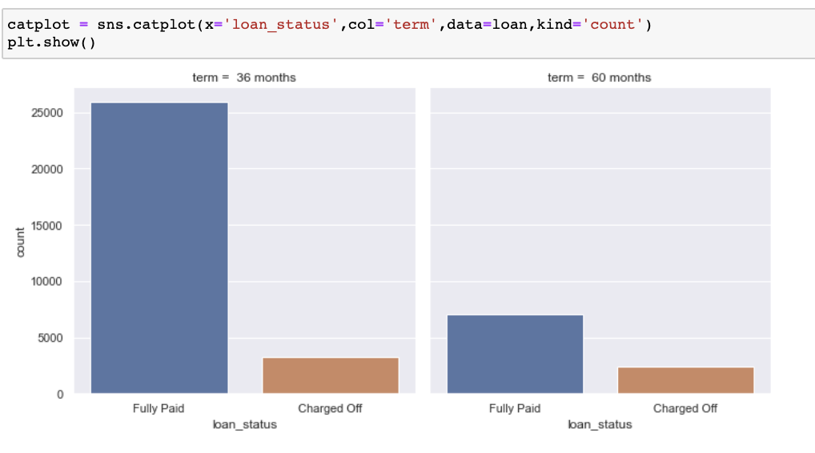
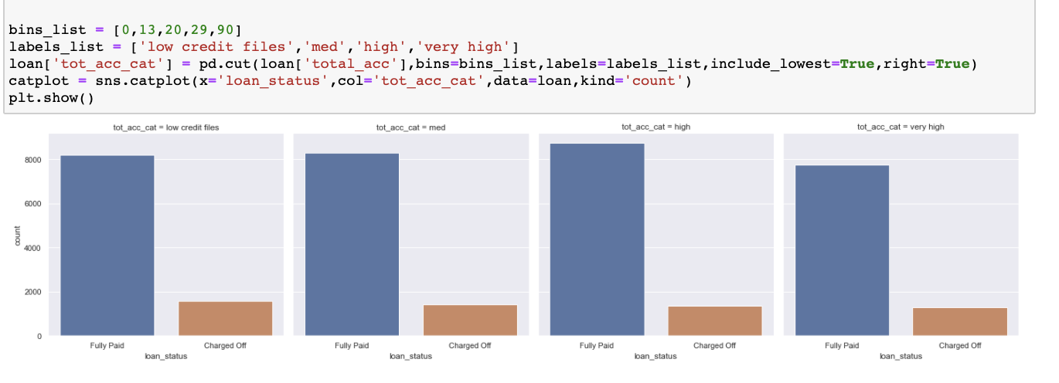
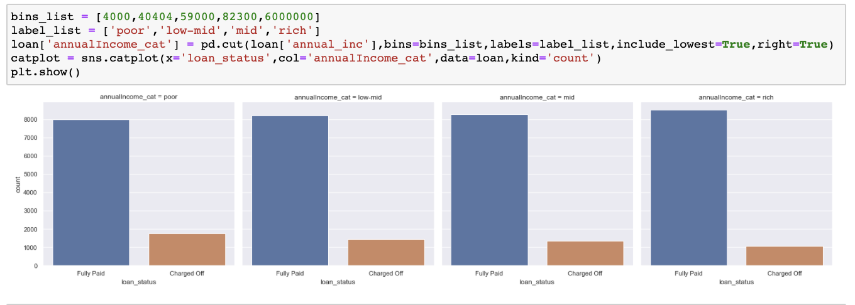
UNIVARIATE: SEGMENTED ANALYSIS – SAMPLE CHARTS

Slide 12
UNIVARIATE: SEGMENTED ANALYSIS - INFERENCE
Home Ownership vs Loan Status: Those who don’t own a home are more likely to default.
Term vs Loan Status: Long term loans are more likely to be charged off.
Low-income group is more likely to not fully pay the loan.

Slide 13
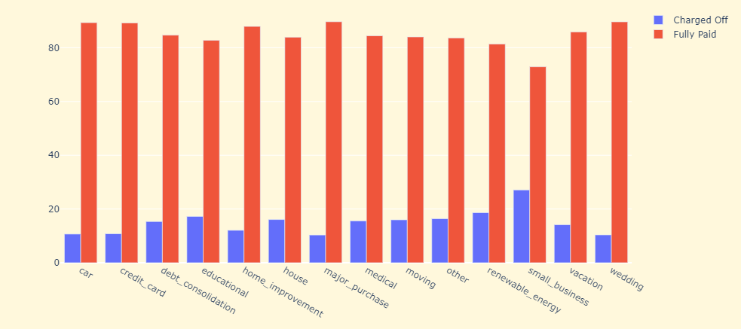
UNIVARIATE: SEGMENTED ANALYSIS SAMPLE CHARTS

Slide 14
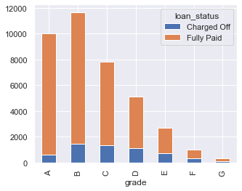
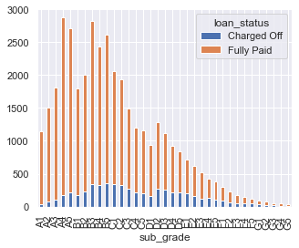
UNIVARIATE: SEGMENTED ANALYSIS SAMPLE CHARTS

Slide 15
UNIVARIATE: SEGMENTED ANALYSIS - INFERENCE
Purpose vs Loan Status: Small businesses are more likely to default.
Grade vs Loan Status: Grade C is more likely to not fully pay the loan. While B5 seems to have the highest charged off rate.

Slide 16
BIVARIATE ANALYSIS
Heatmaps, Pivot tables are used to analyse Continuous variables and categorical variables respectively.
Observed and calculated percentage values are plotted using barplot.
Constructing a pivot table to calculate the percentage of funded amount for each state considering the loan statuses
Constructing a pivot table limiting to top 5 states and calculating the charge off and full paid percentage for each purpose of loans
BAR charts are used to infer that Funded_amnt_inv, installment, emp_length, total_acc, annual_inc are excluded for further analysis

Slide 17
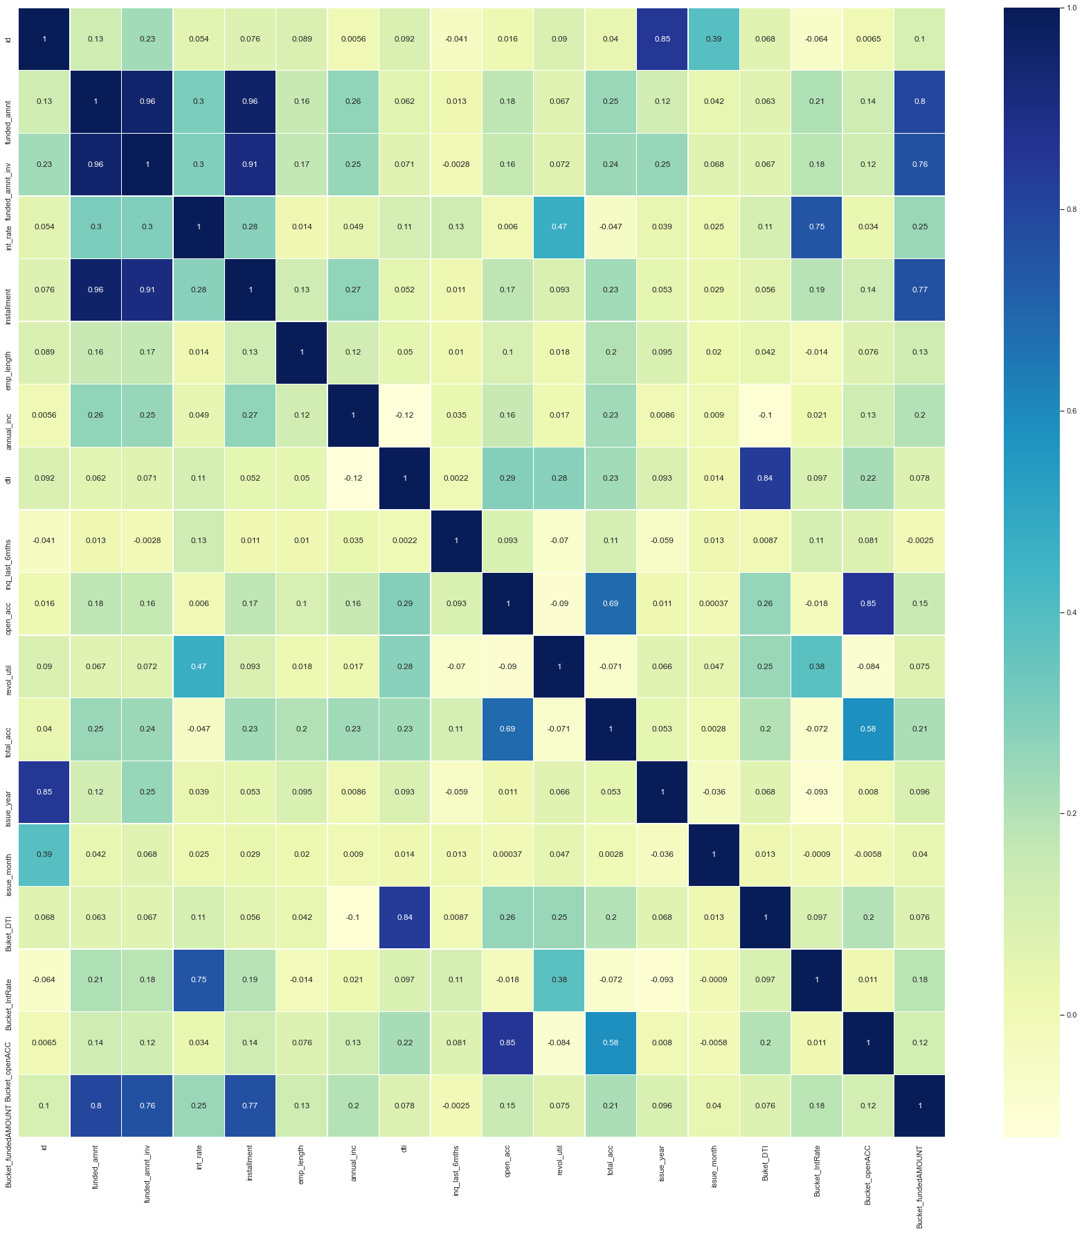
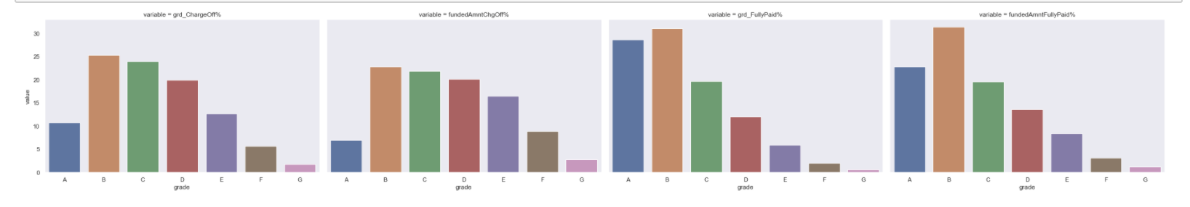
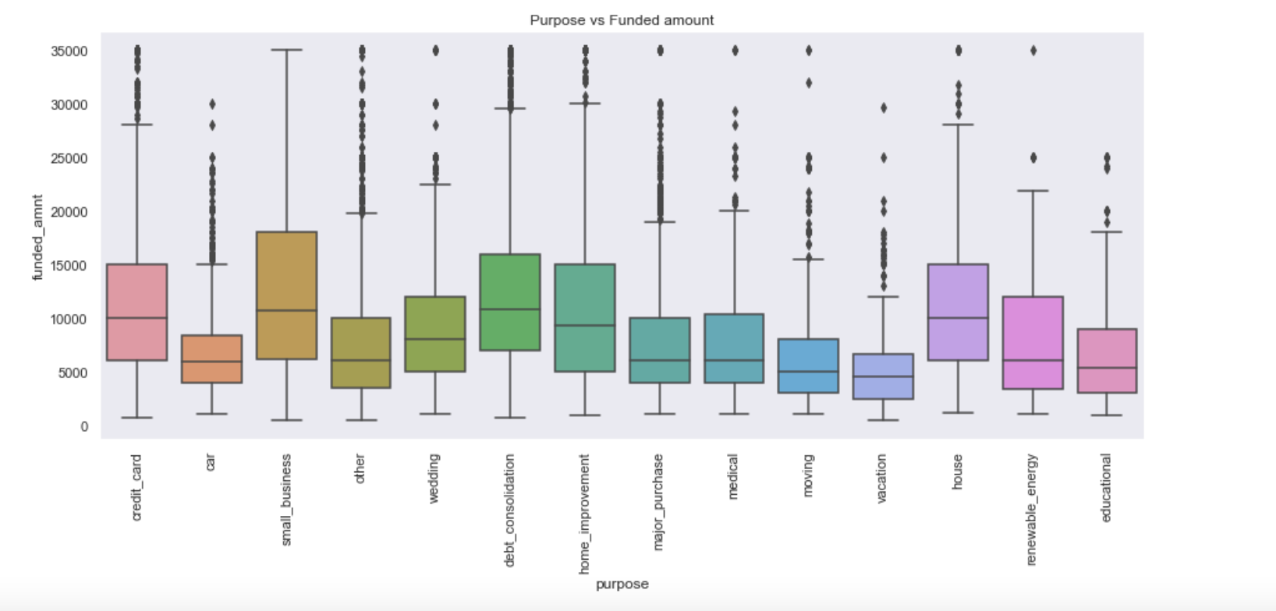
BIVARIATE ANALYSIS: SAMPLE CHARTS

Slide 18
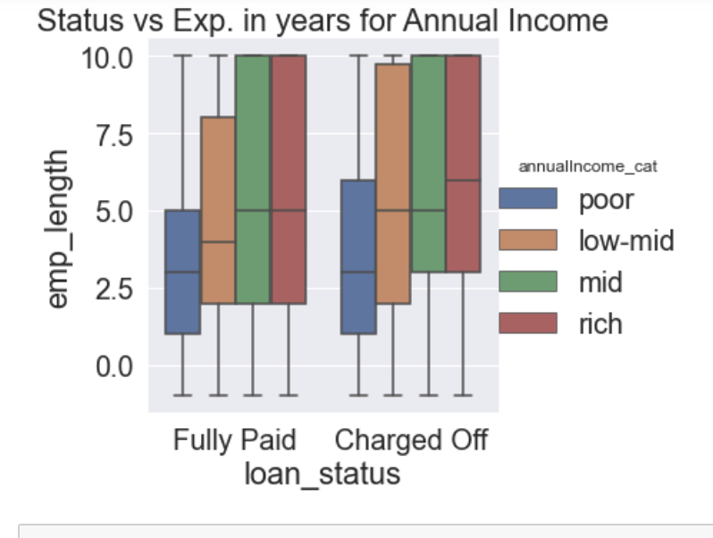
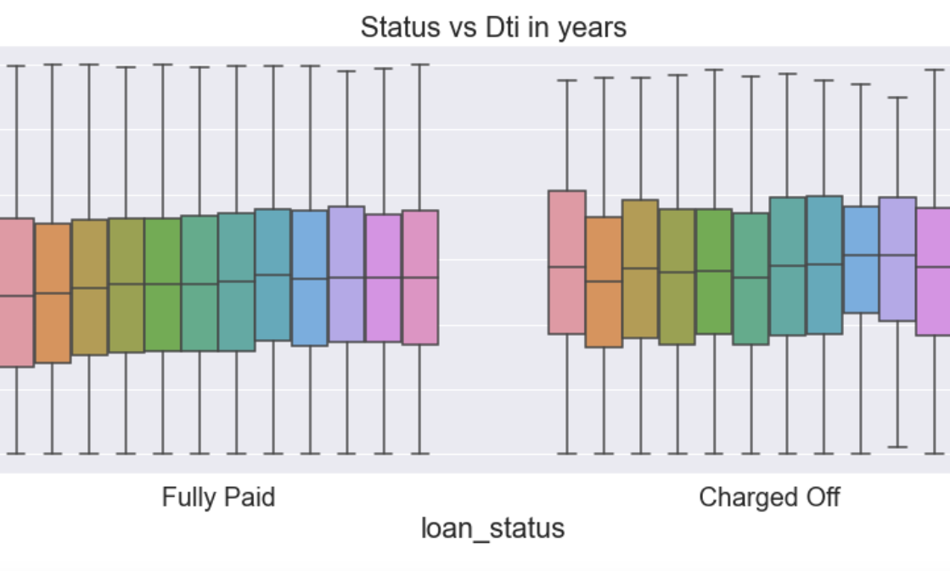
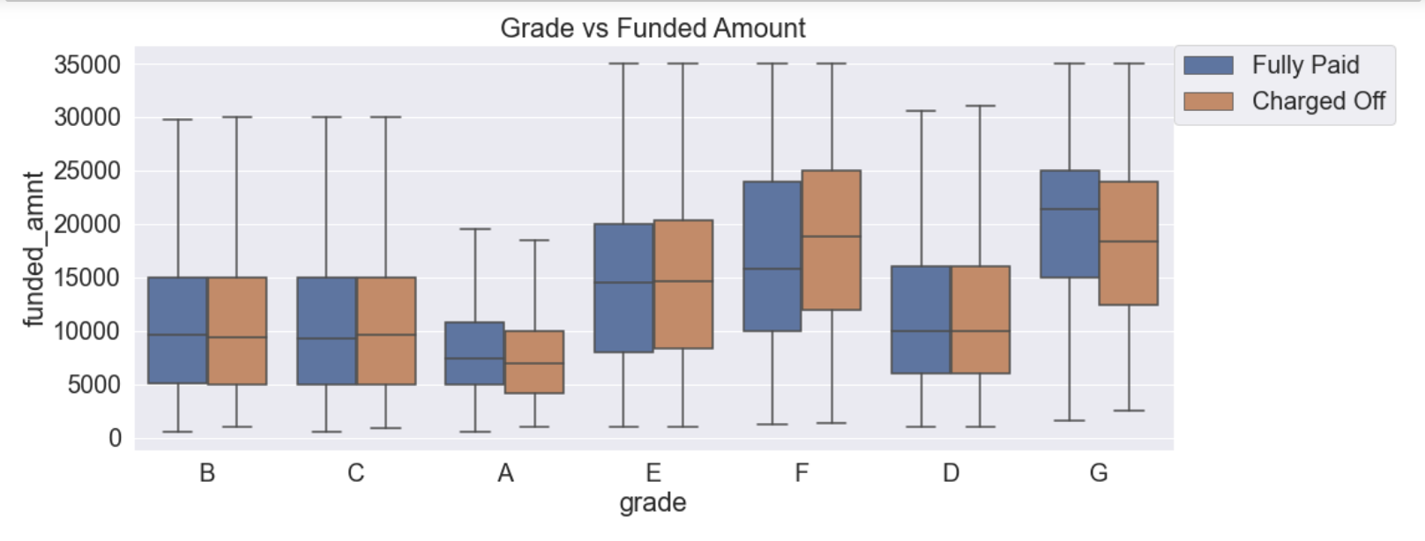
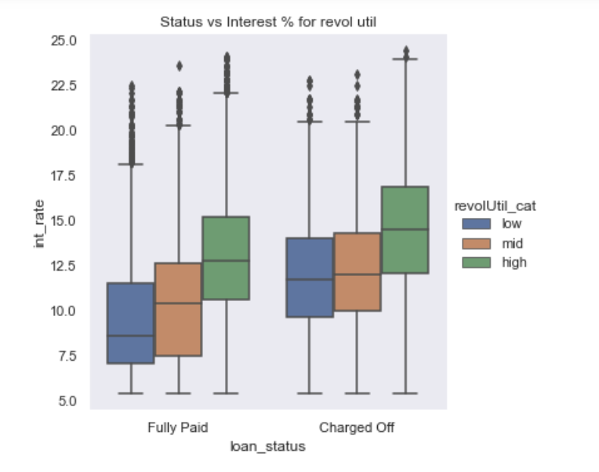
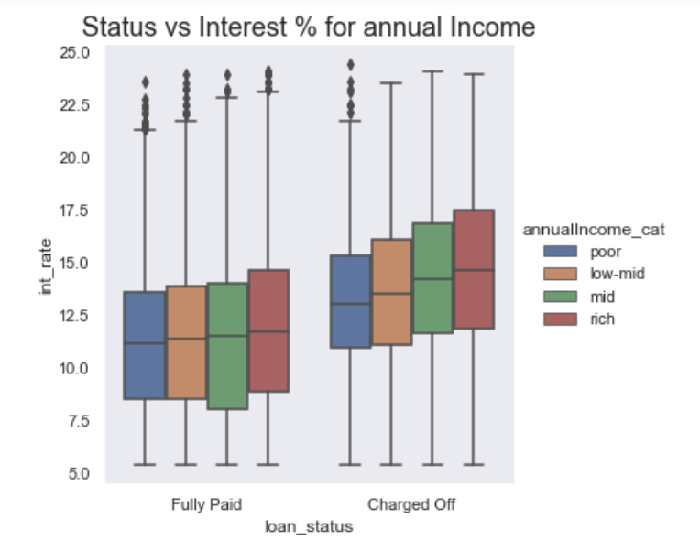
BIVARIATE ANALYSIS: SAMPLE CHARTS

Slide 19
DERIVED METRICS - ANALYSIS
The following derived columns are determined:
Dti_bucket: has new grouping based on dtiranges
Int_rate_bucket: has new grouping based on int_ratecolumn
Open_acc_bucket: has new grouping based on open_acccolumns
Funded_amt_bucket: has new grouping based on funded amount

Slide 20
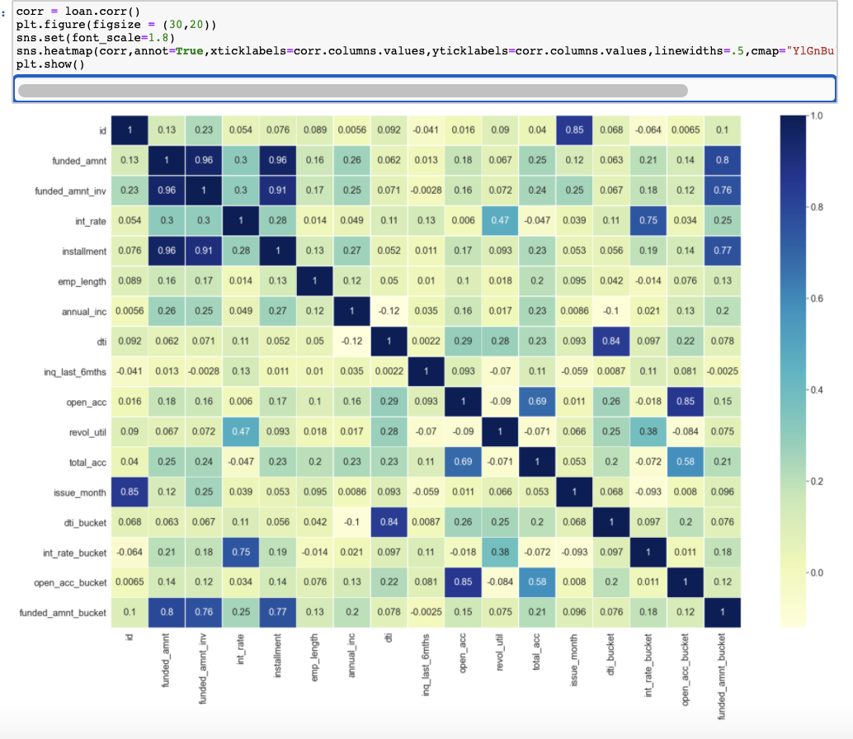
Correlation Chart - Derived Metrics
Funded_amnt is highly correlated with funded_amnt_inv & installment.
The Derived metrics column funded_amnt_bucket is highly correlated to funded_amnt_inv & installment & Funded_amnt .
Int_rate and int_rate_bucket has high correlation value of .75.
Dti & dti_bucket are highly correlated too with value of 0.84 and hence we can use derived column for analysis.
Open_acc and open_acc_bucket are highly correlated with value of .85
After dropping these features, 22 features remained for further analysis

Slide 21
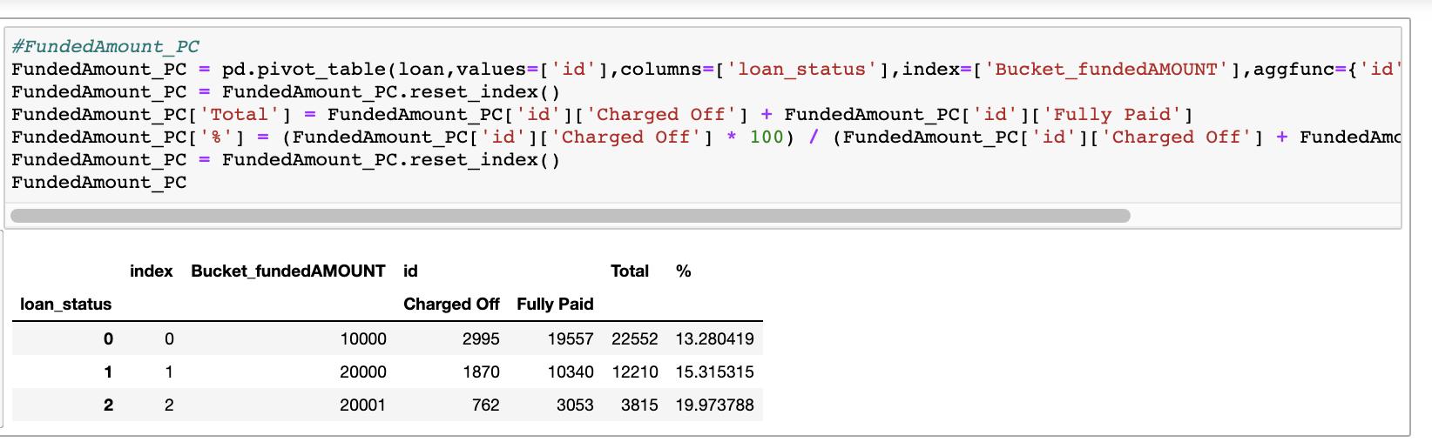
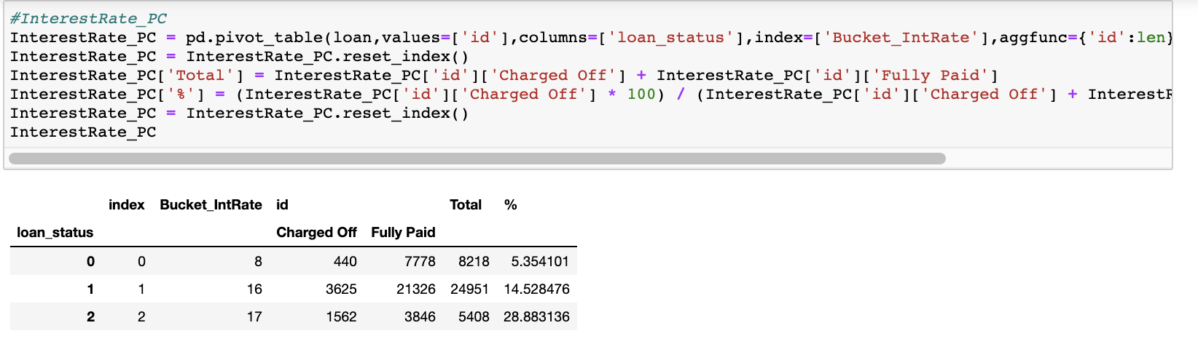
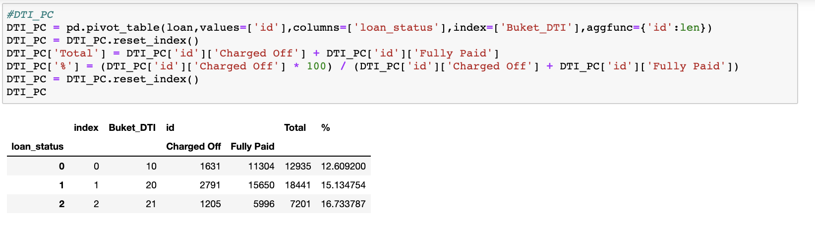
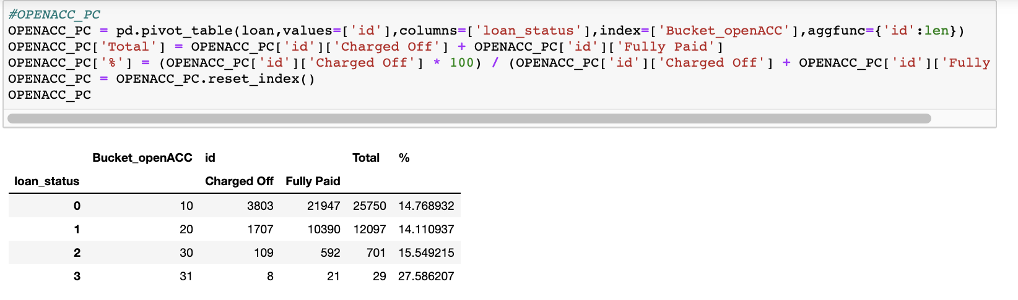
DRIVER VARIABLES - ANALYSIS

Slide 22
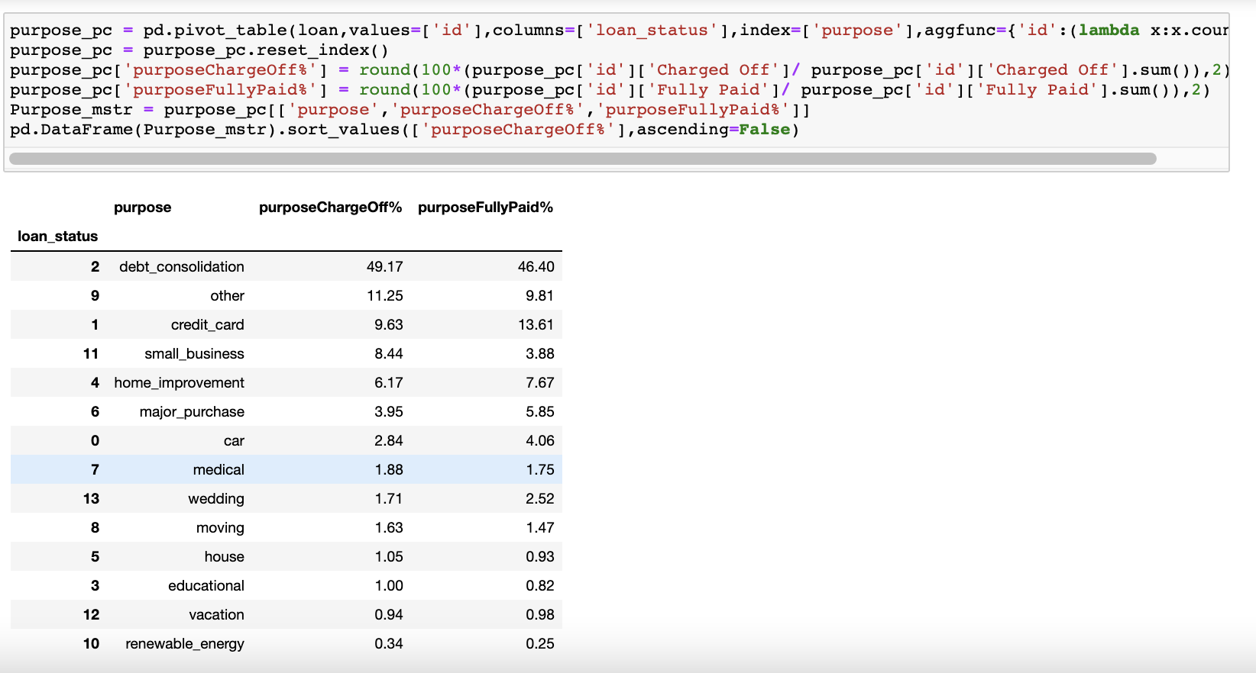
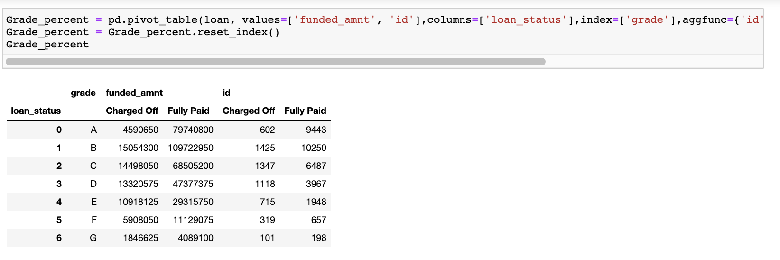
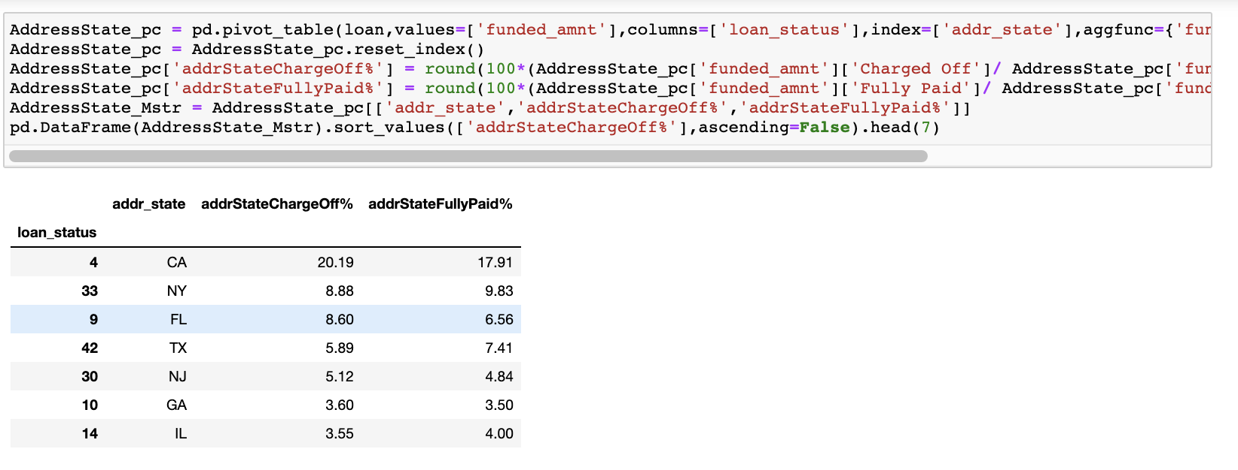
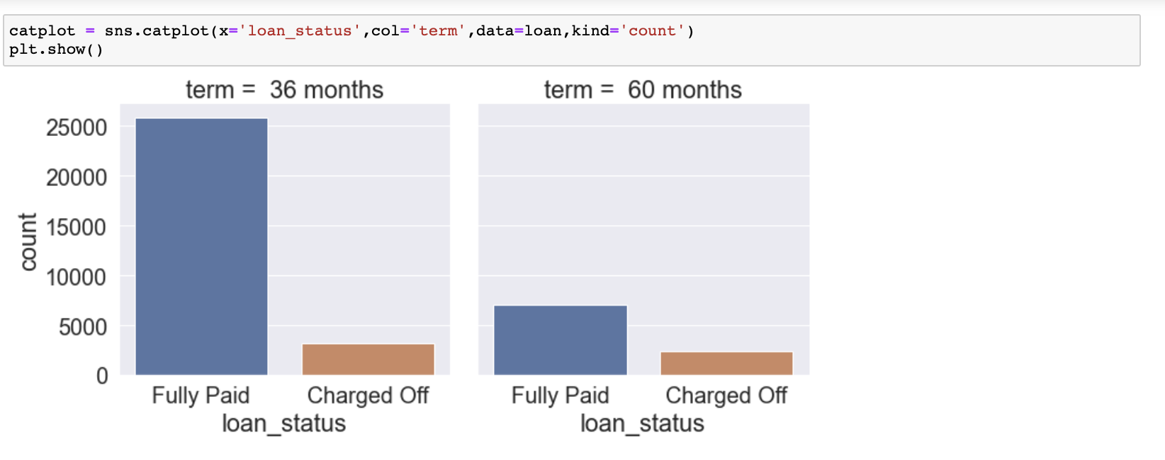
DRIVER VARIABLES – ANALYSIS (contd)

Slide 23
CONCLUSION
Via EDA analysis, it is concluded the following feature sets has maximum impact in determining potential defaulting applicant.
Shortlisted quantitative variables/measures:
funded_amnt (or derived column funded_amnt_bucket), int_rate (or derived column int_rate_bucket), Dti (or derived column int_rate_bucket), open_acc (or derived column open_acc_bucket)
Shortlisted categorical driver variables:
Purpose, term, grade, addr_state

